Slide 1

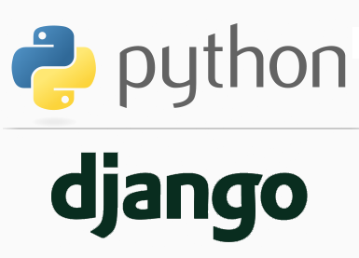
FULL STACK WEB DEVELOPMENT WITH DJANGO
Lecture 7

Slide 2

Today’s Agenda
Developing Our Django App
Creating Multiple Apps In a Single Project
Steps Required
Generating Calendar For Browser
Configuring Multiple URLs
Solving The Name Conflicts
Running Multiple Apps

Slide 3
Creating Multiple Apps In a Single Project
As previously discussed , an app in Django is created to perform a particular functionality for our entire web application (Django Project)
Thus a single Django Project can have multiple apps where each app serves a specific purpose.
For example a College project can have registration app, login app ,course app , fee app etc

Slide 4
Steps Required For Creating Multiple Apps
To create and run multiple Django app , we first have to create a project that will contain these apps and the steps for this will be same as we saw earlier
Open the main folder i.e. root folder called myvsdjangoproject or myanothervsdjangoproject in VS Code
Activate the virtual environment through command pallette
Open the terminal
Create a new django project by executing the command
django-admin startproject demoproject3

Slide 5
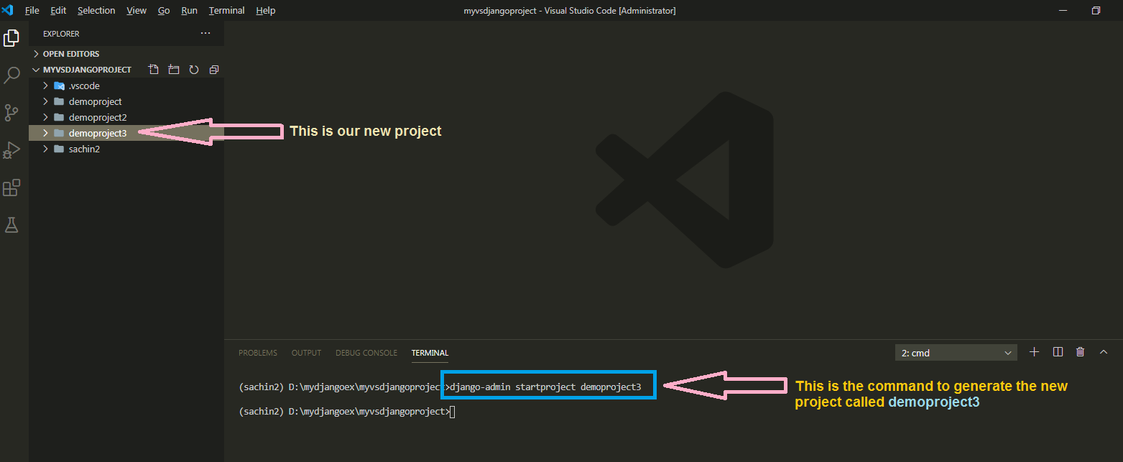
Steps Required For Creating Multiple Apps

Slide 6
Steps Required For Creating Multiple Apps
Now , in the demoproject3 we will create two apps called datetimeapp and calendarapp .
The datetimeapp will show both date and time while the calendarapp will show the current months calendar

Slide 7
Steps Required For Creating Multiple Apps
To create these two apps we need to follow the app creation steps as we discussed in the previous slide but we will have to repeat first 4 steps 2 times:
Creating the app
Activating the app
Creating the View
Configuring the View in Url
Running the server
Opening the page in browser
Repeat these steps for datetimeapp and calendarapp

Slide 8
Step 1:Creating The datetime App
To create datetimeapp we will go to the outer demoproject3 folder and run the following command:
django-admin startapp datetimeapp
When we execute the above command Django will create appropriate file/folder structure for our app

Slide 9
Step 1:Creating The calendar App
To create calendarapp we will again repeat the previous step from the demoproject3 folder and run the following command:
django-admin startapp calendarapp
When we execute the above command Django will create appropriate file/folder structure for calendarapp too

Slide 10
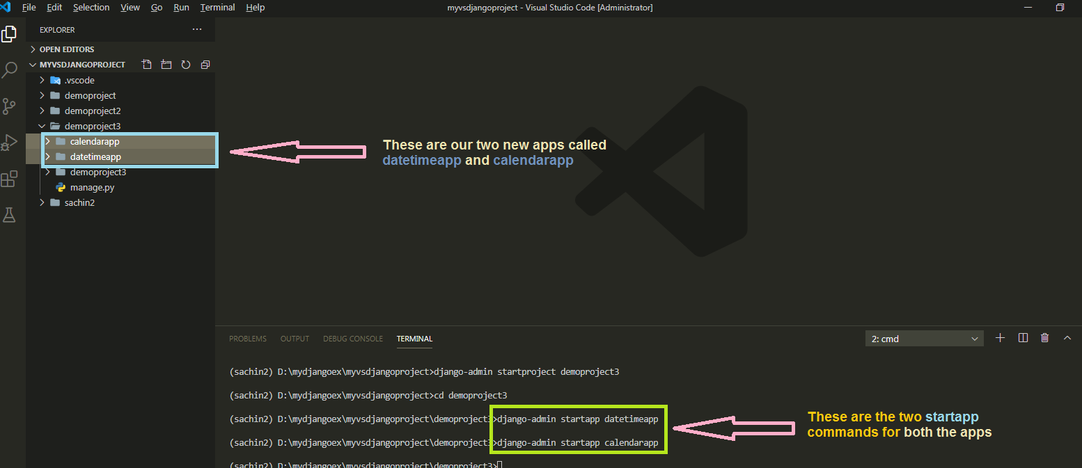
Both Apps Created

Slide 11
Step 2: Activating The App
Once we have created both the apps we must let Django know about them.
To do this we must make two entries , one for datetimeapp and another for calendarapp in the INSTALLED_APPS list of the settings.py file of the inner demoproject3 folder

Slide 12
Step 2: Activating The App
Open the settings.py file in the inner demoproject3 folder and make the two entries shown in green color in the INSTALLED_APPS list
Code:
INSTALLED_APPS = [
'django.contrib.admin',
'django.contrib.auth',
'django.contrib.contenttypes',
'django.contrib.sessions',
'django.contrib.messages',
'django.contrib.staticfiles',
‘datetimeapp',
‘calendarapp’,
]

Slide 13
Step 3:Creating The View For datetimeapp
Since the datetimeapp needs to display both , date and time , so we will create a function called showdatetime() in views.py file of the datetimeapp
Open the views.py file of datetimeapp and write the code shown in the next slide

Slide 14
Step 3:Creating The View For datetimeapp
from django.shortcuts import render
from datetime import datetime
from django.http import HttpResponse
def showDateTime(request):
currDateTime = datetime.now()
currDate = currDateTime.strftime("%d-%b-%Y")
currTime=currDateTime.strftime(“%I:%M:%S %p")
text = f'<h2>Current date and time are {currDate} , {currTime}</h2>'
return HttpResponse(text)

Slide 15
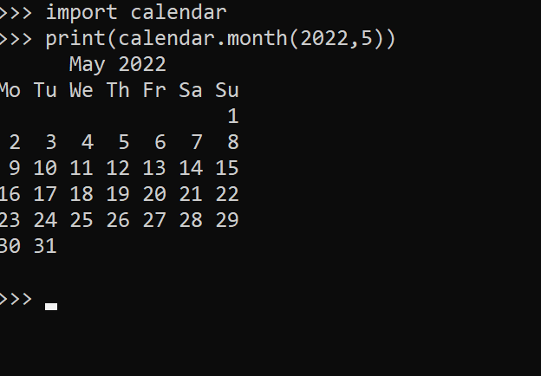
Step 3:Creating The View For calendarapp
To display calendar of a month we have a module in Python called calendar which allows us to display calendar of any month.
This module has a function called month() which accepts 2 arguments representing year and month number and returns a string containing the calendar for that month.

Slide 16
Step 3:Creating The View For calendarapp
But we cannot use this function because the string returned by it contains \n for newline which cannot be understood by the browser.
To overcome this problem we need to use a class called HTMLCalendar which is also available in the module calendar and gives us a calendar in the form HTML table , which can be easily displayed by the browser.

Slide 17
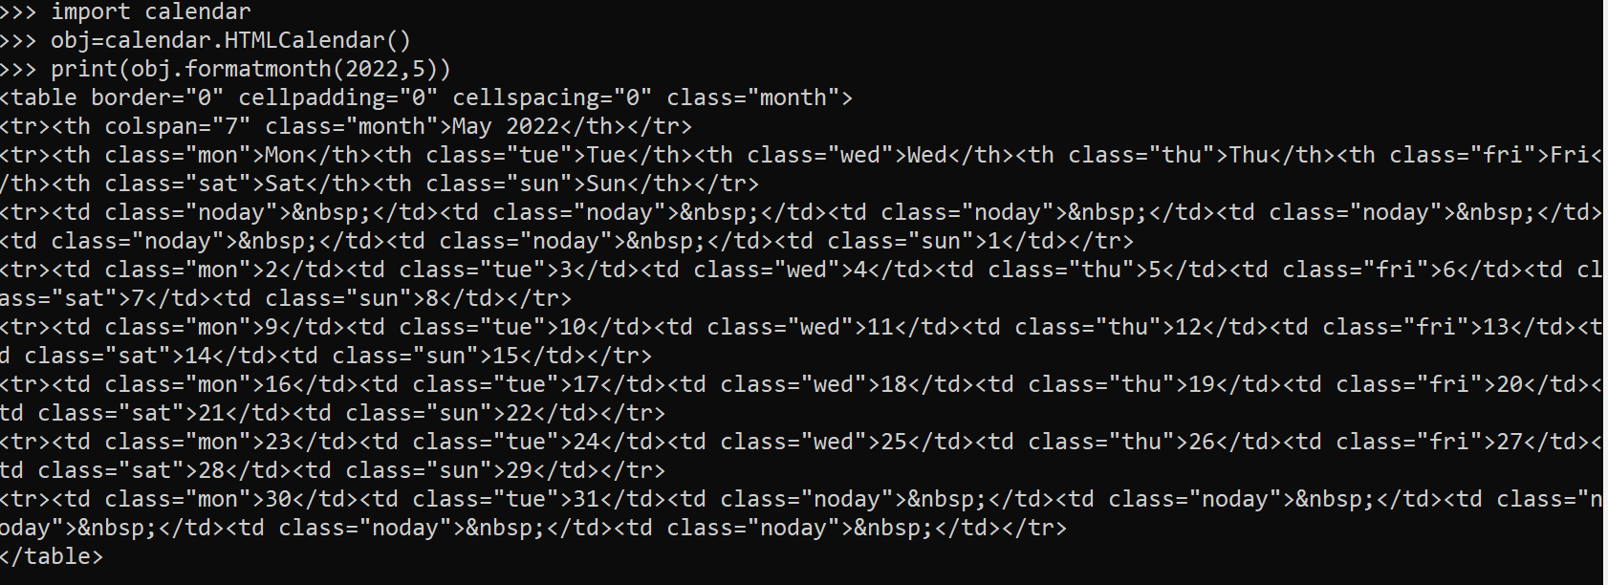
Step 3:Creating The View For calendarapp
The class HTMLCalendar has an instance method called formatmonth() which accepts 2 arguments representing year and month number and returns an string containing the calendar for that month as an HTML table.

Slide 18
Step 3:Creating The View For calendarapp
Open the views.py file of datetimeapp and write the following code in it:
from django.shortcuts import render
from datetime import datetime
from calendar import HTMLCalendar
from django.http import HttpResponse
def showCalendar(request):
currDateTime = datetime.now()
currYear = currDateTime.year
currMonth=currDateTime.month
obj = HTMLCalendar()
text = obj.formatmonth(currYear, currMonth)
return HttpResponse(text)

Slide 19
Step 4:Configuring The Url
After creating and updating the views.py as shown in the previous slide if we must configure both the views in the urls.py of the demoproject app .
But here we will have to face a problem .
Can you guess what ?

Slide 20
Step 4:Configuring The Url
The problem is that if we will import both the views as shown below :
from datetimeapp import views
from calendarapp import views
Then the second import will replace the first import since Python overwrites entities with the same name.

Slide 21
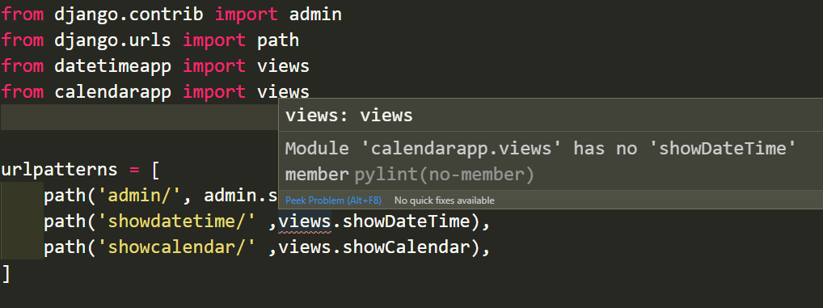
Step 4:Configuring The Url
Due to this we will not be able to access datetimeapp’s view function showDateTime in urls.py as shown in the following image

Slide 22
Step 4:Configuring The Url
To overcome this problem we have 2 solutions:
Solution 1 : Use aliasing
from datetimeapp import views as dv
from calendarapp import views as cv
Solution 2 : Directly import the function
from datetimeapp.views import showDateTime
from calendarapp.views import showCalendar

Slide 23
Step 4:Configuring The Url
So , we must open the file urls.py in the demoproject3 folder and write the following code in it.
Code (demoproject3/urls.py):
from django.contrib import admin
from django.urls import path
from datetimeapp import views as dv
from calendarapp import views as cv
urlpatterns = [
path('admin/', admin.site.urls),
path('showdatetime/' ,dv.showDateTime),
path('showcalendar/' ,cv.showCalendar),
]

Slide 24
Code Explained
urlpatterns = [
path('admin/', admin.site.urls),
path('showdatetime/' ,dv.showDateTime),
path('showcalendar/' ,cv.showCalendar),
]
This list contains the URL pattern showdatetime registered for the datetimeapp’s showDateTime view .
So if a url like http://127.0.0.1:8000/showdatetime arrives then it will be redirected to showDateTime() function of datetimeapp’s views.py..
Similarly if the url http://127.0.0.1:8000/showcalendar arrives then Django will call the function showCalendar() defined in views.py of calendarapp

Slide 25
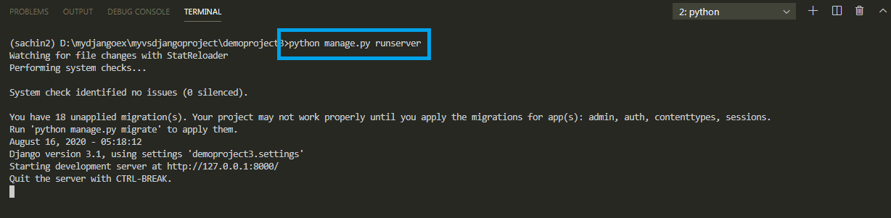
Step 5:Running The Server
To run our new datetimeapp and calendarapp go to the folder demoproject3 by using cd command and type the runserver command in VS Code terminal
cd demoproject3
python manage.py runserver.
The server runs on the default port 8000, and we’llsee output like the following output in the terminal window:

Slide 26
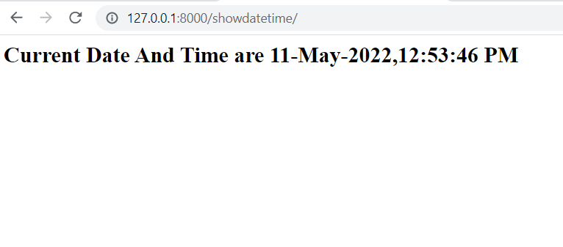
Step 6: Opening The Page
Type the http://127.0.0.1:8000/showdatetime URL in browser to navigate to
that address. Now we should see current date and time as the output

Slide 27
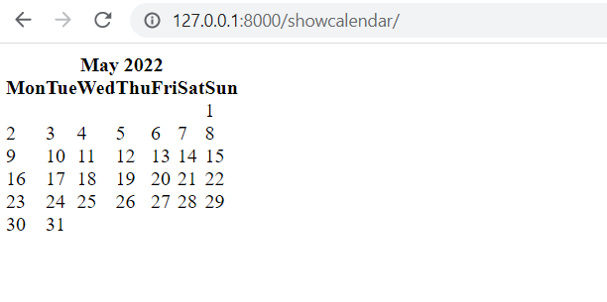
Step 6: Opening The Page
Type the http://127.0.0.1:8000/showcalendar URL in browser to navigate to
that address. Now we should see current month’s calendar as the output

